Slide 1

Turbo Editor
108-2 Software Testing and Verification
Final Presentation#6
古兆瑋(108598019)、陳冠穎(108598034)、劉孝忠(108598044)

Slide 2
Outline
1. Planned Test Criteria and Testing Tools
2. Test Case Design Methods
3. Live Demo
4. Test Result and Summary
5. Project Information
6. Lessons Learned

Slide 3
1. Planned Test Criteria and Testing Tools

Slide 4
Item Pass/Fail Criteria (1/3)
User Scenario Technique:
Test Item的Pass/Fail判斷標準，以一功能之敘述句，在測試執行後是否成立為Pass/Fail標準，假使功能測試執行後，使敘述句成立則Pass；反之則Fail，而本次測試之目標為使所有與Features To Be Tested有關之Test Case通過測試(Pass)。
Notes:
證明軟體有達成使用案例的需求。

Slide 5
Item Pass/Fail Criteria (2/3)
Control-Flow Graph Coverage Technique:
以Basis Path Approach，須覆蓋所有分支，意即Statement Coverage及Branch Coverage是100%。
Notes:
證明測試案例是有實際將該段程式碼執行過的

Slide 6
Item Pass/Fail Criteria (3/3)
不論判斷標準為何，最終希望本次測試能夠達成80%的Code Coverage，證明因為測試涵蓋這麼高的覆蓋率，所以測試的結果是可以信任的。
Notes:
證明測試案例是有實際將該段程式碼執行過的

Slide 7

Test Tool - Espresso & UI Automator
Notes:
Android Studio

Slide 8
2. Test Case Design Methods

Slide 9
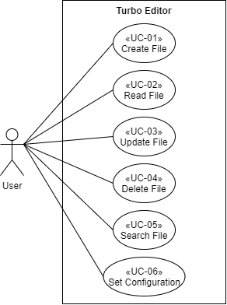
Use Case → Features to be Tested
Feature ID | Description | Use Case
F-T-01 | Create New File | Create File
F-T-02 | Open File | Read File
F-T-03 | Read File’s Info
F-T-04 | Rename File | Update File
F-T-05 | Edit File
F-T-06 | Undo Editing
F-T-07 | Redo Editing
F-T-08 | Search File with REGEX | Search File
F-T-09 | Search File with MATCH CASE
F-T-10 | Search File with REPLACE
F-T-11 | Set Line Numbers | Set Configuration
F-T-12 | Set Syntax Highlight
F-T-13 | Set Wrap Content
F-T-14 | Set Use Monospace
F-T-15 | Set Read Only
F-T-16 | Set Font Size
F-T-17 | Set Theme
F-T-18 | Set Accessory View
F-T-19 | Set Use the storage Access Framework
F-T-20 | Set Keyboard Suggestion and Swipe
F-T-21 | Set Auto Save
F-T-22 | Set Encoding
F-T-23 | Set Ignore Back Button
F-T-24 | Set Split The Text If Too Long
F-T-25 | Set Fullscreen Mode
F-T-26 | Set Open Last Viewed File At Startup

Slide 10
Features to be Tested → Test Req.
Feature ID | Description | Use Case
F-T-01 | Create New File | Create File
F-T-02 | Open File | Read File
F-T-03 | Read File’s Info
F-T-04 | Rename File | Update File
F-T-05 | Edit File
F-T-06 | Undo Editing
F-T-07 | Redo Editing
F-T-08 | Search File with REGEX | Search File
F-T-09 | Search File with MATCH CASE
F-T-10 | Search File with REPLACE
F-T-11 | Set Line Numbers | Set Configuration
F-T-12 | Set Syntax Highlight
F-T-13 | Set Wrap Content
F-T-14 | Set Use Monospace
F-T-15 | Set Read Only
F-T-16 | Set Font Size
F-T-17 | Set Theme
F-T-18 | Set Accessory View
F-T-19 | Set Use the storage Access Framework
F-T-20 | Set Keyboard Suggestion and Swipe
F-T-21 | Set Auto Save
F-T-22 | Set Encoding
F-T-23 | Set Ignore Back Button
F-T-24 | Set Split The Text If Too Long
F-T-25 | Set Fullscreen Mode
F-T-26 | Set Open Last Viewed File At Startup
Test ID | Description | Related Use Case
TD-01 | Create New File | Create File
TD-02 | Open File | Read File
TD-03 | Read File’s Info
TD-04 | Rename File | Update File
TD-05 | Edit File
TD-06 | Undo Editing
TD-07 | Redo Editing
TD-08 | Search File with REGEX | Search File
TD-09 | Search File with MATCH CASE
TD-10 | Search File with REPLACE
TD-11 | Set Line Numbers | Set Configuration
TD-12 | Set Syntax Highlight
TD-13 | Set Wrap Content
TD-14 | Set Use Monospace
TD-15 | Set Read Only
TD-16 | Set Font Size
TD-17 | Set Theme
TD-18 | Set Accessory View
TD-19 | Set Use the storage Access Framework
TD-20 | Set Keyboard Suggestion and Swipe
TD-21 | Set Auto Save
TD-22 | Set Encoding
TD-23 | Set Ignore Back Button
TD-24 | Set Split The Text If Too Long
TD-25 | Set Fullscreen Mode
TD-26 | Set Open Last Viewed File At Startup
Notes:
Test Req. = Test Requirement

Slide 11
Test Req. Covered by Test Case
Test Case ID | Description | Related Test Item
TC-01 | Create File | TD-01
TC-02 | Read File | TD-02、TD-03
TC-03 | Update File | TD-04、TD-05、TD-06、TD-07
TC-04 | Search File | TD-08、TD-09、TD-10
TC-05 | Set Configuration | TD-11、TD-12、TD-13、TD-14、TD-15、TD-16、TD-17、TD-18、TD-19、TD-20、TD-21、TD-22、TD-23、TD-24、TD-25、TD-26
TC-06 | Back When Create File | TD-01
TC-07 | Close APP When Create File | TD-01
TC-08 | undo
TC-09 | replaceTextKeepCursor
Notes:
Test Req. = Test Requirement

Slide 12
User Scenario
Test Case ID | TC-04
Test Case Name | Search File
Related Use Case | UC-04
Related Test Item | TD-08、TD-09、TD-10
Scope | Turbo Editor
Input Specification | Launch Application. Click menu button Click "Open a file" on menu. Click search icon. Enter text for searching. Select the wanted file in searching results.
Output Specification | Menu displays on the left side of screen. File explorer shows up. Search field shows up for input Search results displays on screen. The selected file opens after clicking on it.

Slide 13
Control-Flow Graph
Turbo Editor - Test Design Specification & Test Case Specification (pp.12)

Slide 14
3. Live Demo
Notes:
Show the test scripts of sample test cases.
A short Live demo of the test execution. (please provide video for the execution of all test cases)
Show the test results. (show any defects discovered)
Show the test coverage of the features/combinations of features/user requirements.

Slide 15
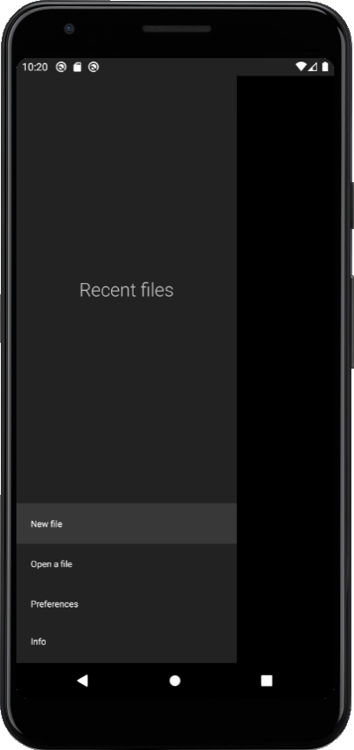
Live Demo (cont’d)
Notes:
Backup demo when we encounter some “technical issues”

Slide 16
4. Test Result and Summary

Slide 17
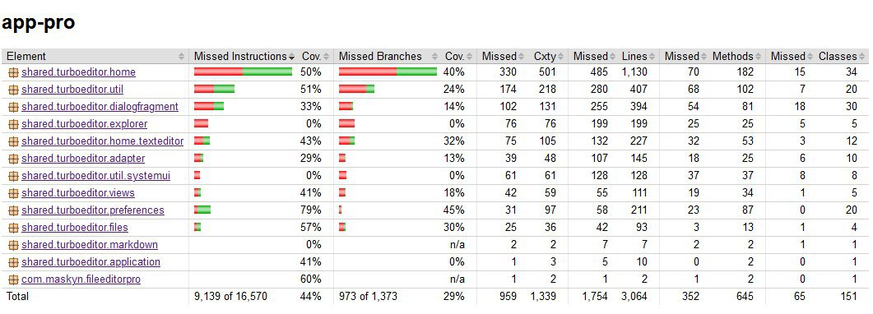
Code Coverage

Slide 18
Test Result
Test Case ID | Description | Pass / Fail
TC-01 | Create File | Pass
TC-02 | Read File | Pass
TC-03 | Update File | Pass
TC-04 | Search File | Pass
TC-05 | Set Configuration | Pass
TC-06 | Back When Create File | Pass
TC-07 | Close APP When Create File | Pass
TC-08 | undo | Pass
TC-09 | replaceTextKeepCursor | Pass
Pass Rate |  | 9/9 (100%)
Code Coverage |  | 44% (<80%)

Slide 19
Test Result Analysis
Test Case ID | Description | Related Test Item
TC-01 | Create File | TD-01
TC-02 | Read File | TD-02、TD-03
TC-03 | Update File | TD-04、TD-05、TD-06、TD-07
TC-04 | Search File | TD-08、TD-09、TD-10
TC-05 | Set Configuration | TD-11、TD-12、TD-13、TD-14、TD-15、TD-16、TD-17、TD-18、TD-19、TD-20、TD-21、TD-22、TD-23、TD-24、TD-25、TD-26
TC-06 | Back When Create File | TD-01
TC-07 | Close APP When Create File | TD-01
TC-08 | undo
TC-09 | replaceTextKeepCursor
Test ID | Description | Related Use Case
TD-01 | Create New File | Create File
TD-02 | Open File | Read File
TD-03 | Read File’s Info
TD-04 | Rename File | Update File
TD-05 | Edit File
TD-06 | Undo Editing
TD-07 | Redo Editing
TD-08 | Search File with REGEX | Search File
TD-09 | Search File with MATCH CASE
TD-10 | Search File with REPLACE
TD-11 | Set Line Numbers | Set Configuration
TD-12 | Set Syntax Highlight
TD-13 | Set Wrap Content
TD-14 | Set Use Monospace
TD-15 | Set Read Only
TD-16 | Set Font Size
TD-17 | Set Theme
TD-18 | Set Accessory View
TD-19 | Set Use the storage Access Framework
TD-20 | Set Keyboard Suggestion and Swipe
TD-21 | Set Auto Save
TD-22 | Set Encoding
TD-23 | Set Ignore Back Button
TD-24 | Set Split The Text If Too Long
TD-25 | Set Fullscreen Mode
TD-26 | Set Open Last Viewed File At Startup

Slide 20
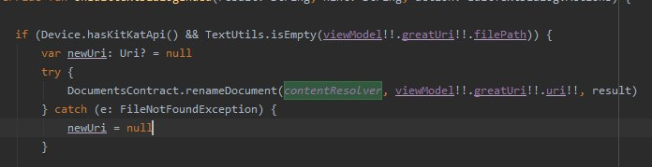
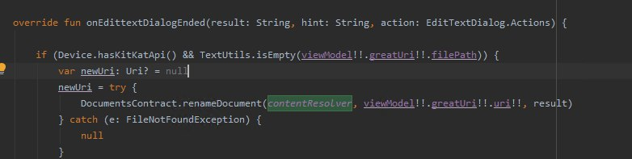
Software Bug Found through Testing

Slide 21
Summary
All test cases were promptly implemented.
We found 1 bug that causes rename function failure.
We are over optimistic about Code Coverage.

Slide 22
5. Project Information

Slide 23
Responsibility of Team Members
姓名 | 主要職稱/角色 | 主要職務/角色描述
古兆瑋 | 測試設計人員 | 進行測試設計，協助測試實作
陳冠穎 | 測試設計人員 | 調控專案時程，協助測試設計及實作
劉孝忠 | 測試實作人員 | 進行測試實作及環境建置
Notes:
備註：角色因故無法執行職務時，得視情況調度其他人員取代或代理其職務。

Slide 24
6. Lessons Learned

Slide 25
Lessons Learned
Testing Criteria (ISP, CFG, etc..)
Android APP Black-box Testing.
Web APP Testing. (Selenium)
Load/Stress Testing. (JMeter)
How to generate Code Coverage by using the right Testing Tools.

Slide 26
Q & A

